Slide 1

OTC DRUG RECOMMENDATION CHATBOT
Supervisor: Sir Khawaja Mohiuddin
Team Members:
Esa Anjum 1712145
Shayan Ur Rehman Siddiqui 1712172

Slide 2
Problem Statement
People aren’t aware of OTC medicines and their safe use i.e. they don’t read manufacturer’s guidelines, active ingredients, side effects and interactions.
When travelling abroad people don’t know medicines by their drug name which makes difficult to purchase the right OTC in case of emergency.
Older adults are at increased risk of adverse drug events due to medication and their interaction with current medications[1].
More than 42% medication errors are caused by doctors when prescribing medicines[2].
Nearly seven in 10 parents have given their child an OTC medicine late at night to help treat a sudden medical symptom[3].
Search engines provide confusing information and both RX and OTC drugs are mentioned, it’s also difficult to find local brands/drugs online.
Self-medication is highly prevalent (84.8%) in Karachi[4].
95 percent pharmacies in Pakistan are run without a pharmacist[5].

Slide 3
Solution Statement
Working:
A web application will be developed that has a chatbot that uses decision tree based algorithm to ask user a series of questions after he/she has initiated a conversation about his/her problem. The chatbot will look for meaningful data in conversations using Natural Language Processing.
The Chatbot will narrow down the problem to become certain of the user’s health issue, known allergies, current medications and then recommend the best suitable OTC medicines along with all important information such as dosage, active ingredient, uses etc.
Medication errors will be reduced as it will check drug-drug interaction, underlying conditions and current medication of the user.

Slide 4
Reliability:
The App will only be used for mild to moderate symptoms, anything severe or chronic if detected the user will be prompted to seek immediate medical help.
Only OTC products will be recommended as they are safe and typically contain usage limitations, i.e., if the condition persists beyond certain days, see a physician.
OTC drugs will be taken from KNOWYOUROTCS.ORG that contains U.S. FDA approved drugs only[6].
Drug’s complete information will be extracted from Pharmapedia Pakistan® such as brand name, indications, interactions etc[7].
All the data will be verified by the Certified Professionals.

Slide 5
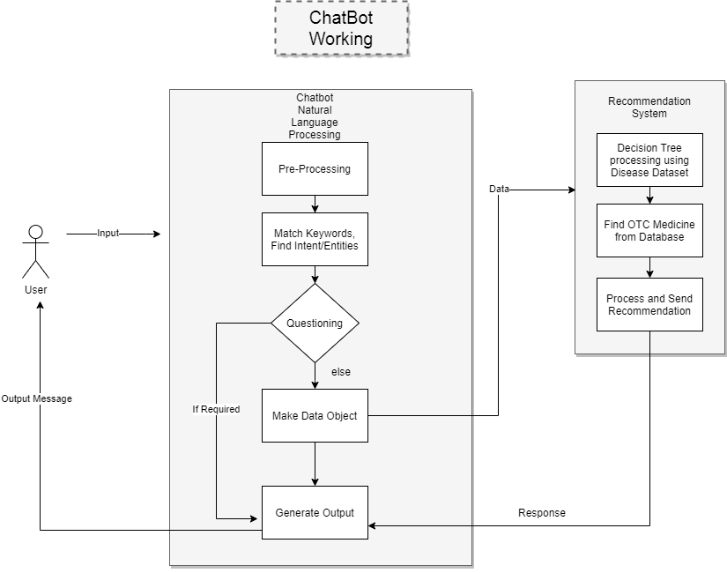
Chatbot Workflow

Slide 6
FYP-I SCOPE
Actor
Patient
Features
Basic UI
Chatbot conversation
Symptoms checking
Illness Severity/Chronicity detection
Disease identification
Drug Interaction checking
Medical condition checking
Common Side effects
Drug name and reliable brand name recommendation.
Outputs
Web Application with basic UI, Chatbot

Slide 7
FYP-II SCOPE
Actor
Patient
Admin
Features
Complete UI
SignIn-SignOut
My Medications, My Medical Conditions
Pill Schedule Generation
Admin Support (complaint processing)
Drug-Drug Interaction checker
Drugs Search w.r.t brand name, drug name, symptoms and side effects
Outputs
Web Application with complete frontend and backend including all the features

Slide 8
Tools and Technologies
Web Application
Front-End: React.js
Back-End: Python Flask Framework
Database: SQLite (RDBMS)
Libraries and Packages: Regular Expressions(NLTK), Wordnet, AI libraries.
Data Sources: Pharmapedia Pakistan® Database[7], KnowyourOTCs[6] website, FDA approved drugs.

Slide 9
References
“Designing an over the counter consumer decision-making tool for older adults”. DOI: https://doi.org/10.1016/j.jbi.2015.07.006.
“An Intelligent Medicine Recommender System Framework” DOI: 10.1109/ICIEA.2016.7603801.
CHPA Presentations at Food and Drug Administration OTC Part 15 Hearing Holiday Inn Gaithersburg, Maryland June 28 and 29, 2000.
“Prevalence and pattern of self-medication in Karachi: A community survey.” DOI: 10.12669/pjms.315.8216
“95 per cent pharmacies in Pakistan are run without a pharmacist” https://gulfnews.com/world/asia/pakistan/95-per-cent-pharmacies-in-pakistan-are-run-without-a-pharmacist-1.1557064220915
“KnowyourOTCs”. CHPA Educational Foundation. https://www.knowyourotcs.org/conditions-and-treatments/.
“Pharmapedia Pakistan”. https://www.pharmapedia.pk/.

Slide 10
THANK YOU

